Slide 1
Stolen Object Tracker
Charlie Baker, Denney Burkholder, Nathan Plotts, Leonardo Reyes, Steven Whaley

Slide 2
Overview
Activate
Identify
Locate
Communicate
A system to track stolen objects and get data that can be used to locate and retrieve the object
Notes:
NATHAN

Slide 3
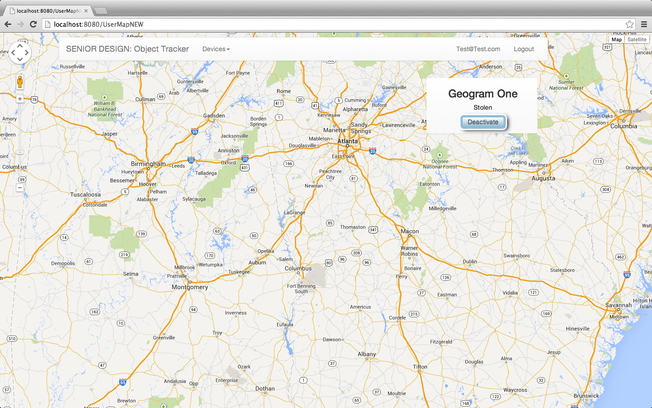
Notes:
NATHAN

Slide 4
Cycle Intent
Main focus on internal server communications and displaying of data on web view
Functions for different queries to the database
No major updates to Windows Service
Notes:
DENNEY

Slide 5
New Features
Adding new devices to the account
Displaying device information based on user session
Traceroutes
Keylogs
GeogramOne sleeps and wakes on motion
Alerts server of the event and begins tracking
Notes:
LEO

Slide 6
User Stories
Completed
User Account Creation
User new device registration
User views device list
User views device data
Adversarial
User reports stolen device (activates device tracking)
Geogram automatically detects when stolen
Notes:
DENNEY

Slide 7
Server
Implemented more functionality to the server’s internal communication
Database functions needed in-order to update and insert new information into database
Retrieving device data based on users’ session
Notes:
LEO

Slide 8
Device Hub
Laptop “checks-in” with the server to see if the device has been reported stolen. If the stolen flag is set, the server sends commands to the laptop to retrieve data and start monitoring
GPS device send coordinates to the server, the server parses the phone number and coordinates to store on database and push to the web socket
Send commands to devices using the device IDs (Geogram: phone number Laptop: MAC Address)
Notes:
NATHAN

Slide 9
Windows Service
Identifier and Stolen status stored in registry
Reconnect to key-logger mid execution
Other minor improvements
Notes:
CHARLIE

Slide 10
Currently Known Issues
SQL injection
User session issues
Not handling duplicate account or device registration
Unencrypted data
More error checking needed
Notes:
CHARLIE

Slide 11
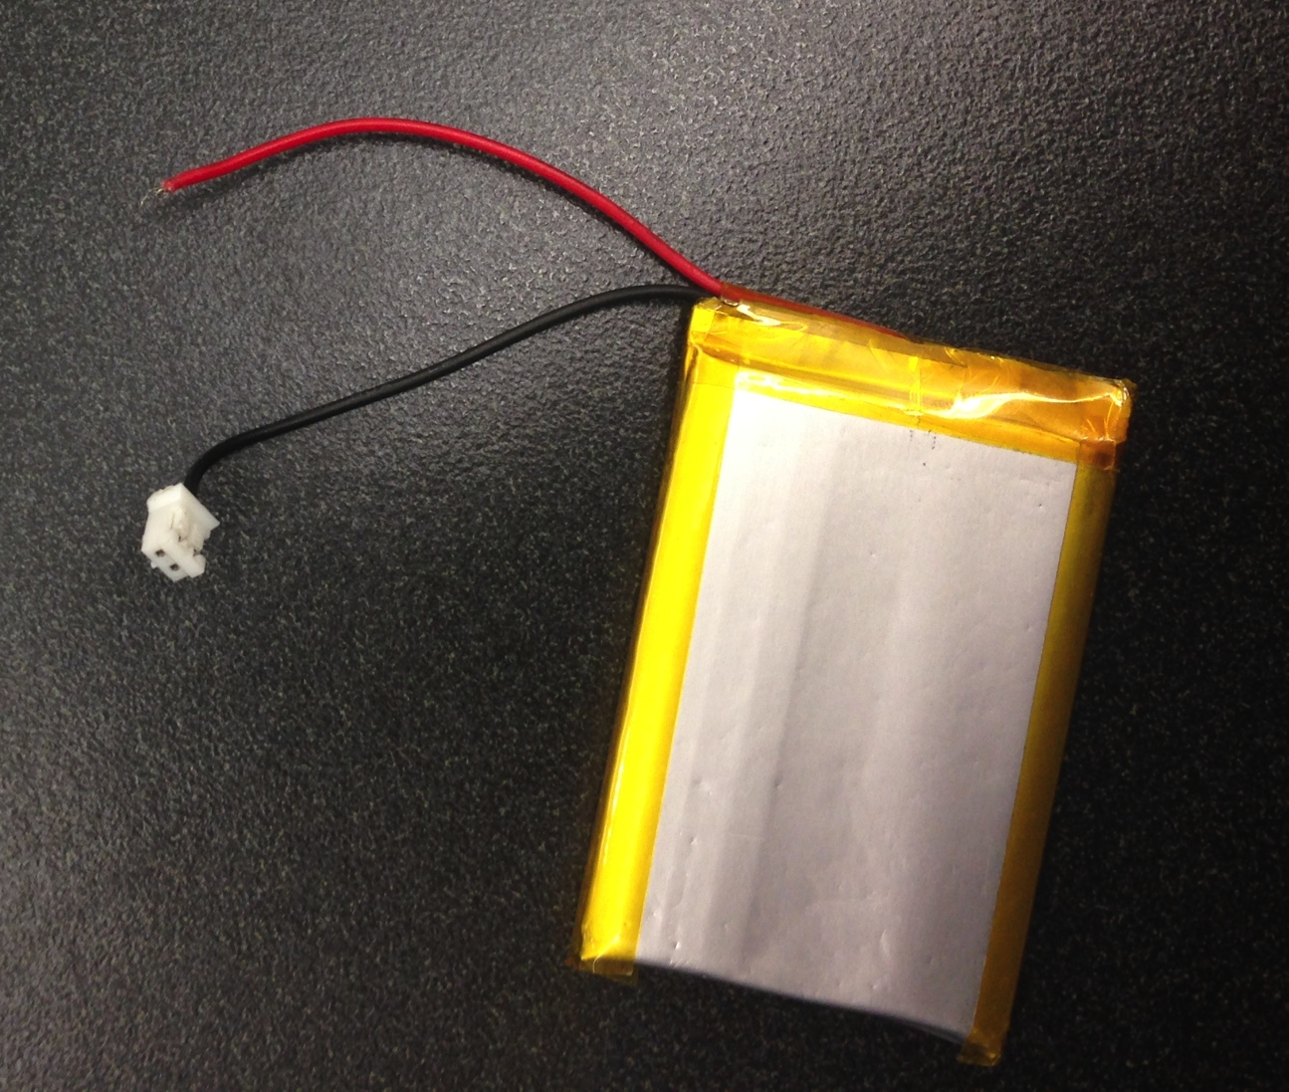
Major Obstacles
Problems with Geogram’s motion activation (resolved)
Server receiving keylog data too fast (resolved)
Geogram battery wire disconnected (unresolved)
Notes:
STEVEN

Slide 12
Future Plans
Implement more error checking and error handling to create a more failsafe server
Add more commands sent from web client
Improve web UI
Geolocation with IP
Notes:
STEVEN

